Slide 1


Selenium And spring boot Automation with jenkinS
Chilukuri Navya Gayathri
201331

Slide 2
contents
Spring boot
Selenium
Jenkins
Eclipse
TestNG

Slide 3
introduction
The project to be discussed, detail the utility of topics of content and is the application of automation testing with selenium and java.

Slide 4
Spring boot Spring Boot is a project that is built on the top of the Spring Framework. It provides an easier and faster way to set up, configure, and run both simple and web-based applications..

Slide 5
Spring Initializr
Spring Initializr is a Web-based tool that generates the Spring Boot project structure
Modern IDEs have integrated Spring Initializr that provides the initial project structure.
Spring Initializr provides an extensible API to generate JVM-based projects,
It is used to inspect the metadata which used for generate projects, for instance to list the available dependencies and versions.

Slide 6
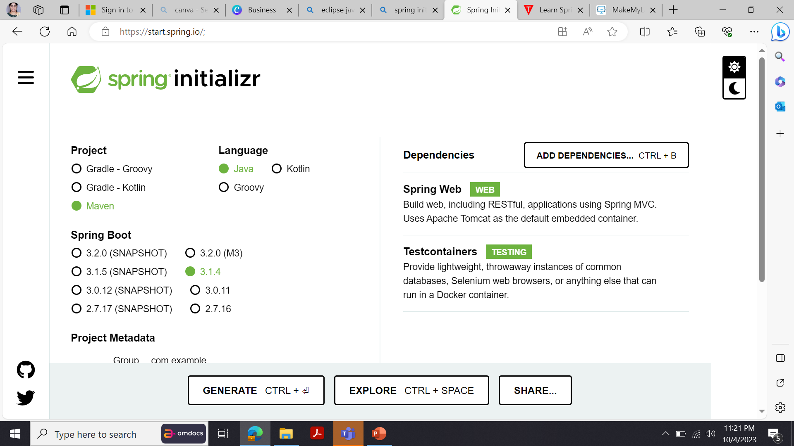
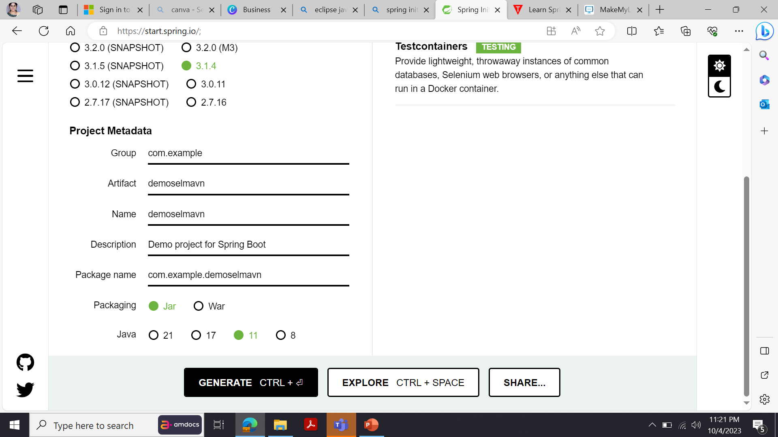
Zip file to be extracted and import to Eclipse which includes pom.xml ,maven dependencies..

Slide 7
Eclipse It is a powerful and versatile Integrated Development Environment (IDE) that provides essential tools for Java developers, including a Java IDE, Git client, XML Editor ,Etc.

Slide 8
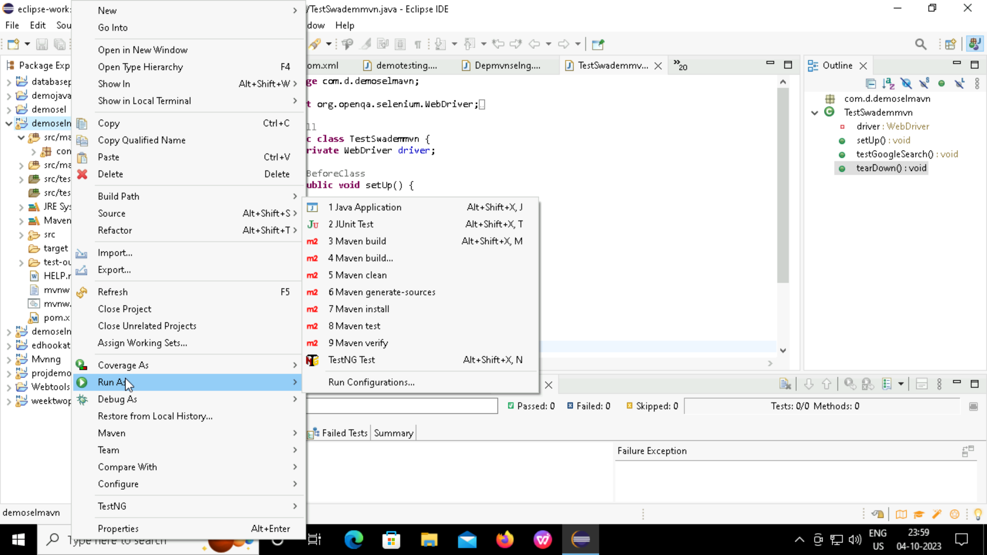

Slide 9
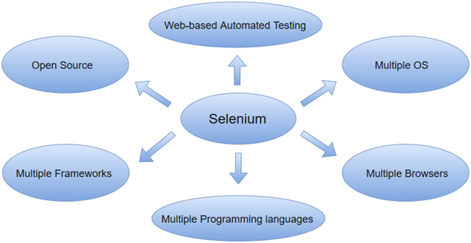
Selenium
Selenium is an open-source tool that automates web browsers
It provides a single interface that lets you write test scripts in programming languages like Ruby, Java, Python

Slide 10
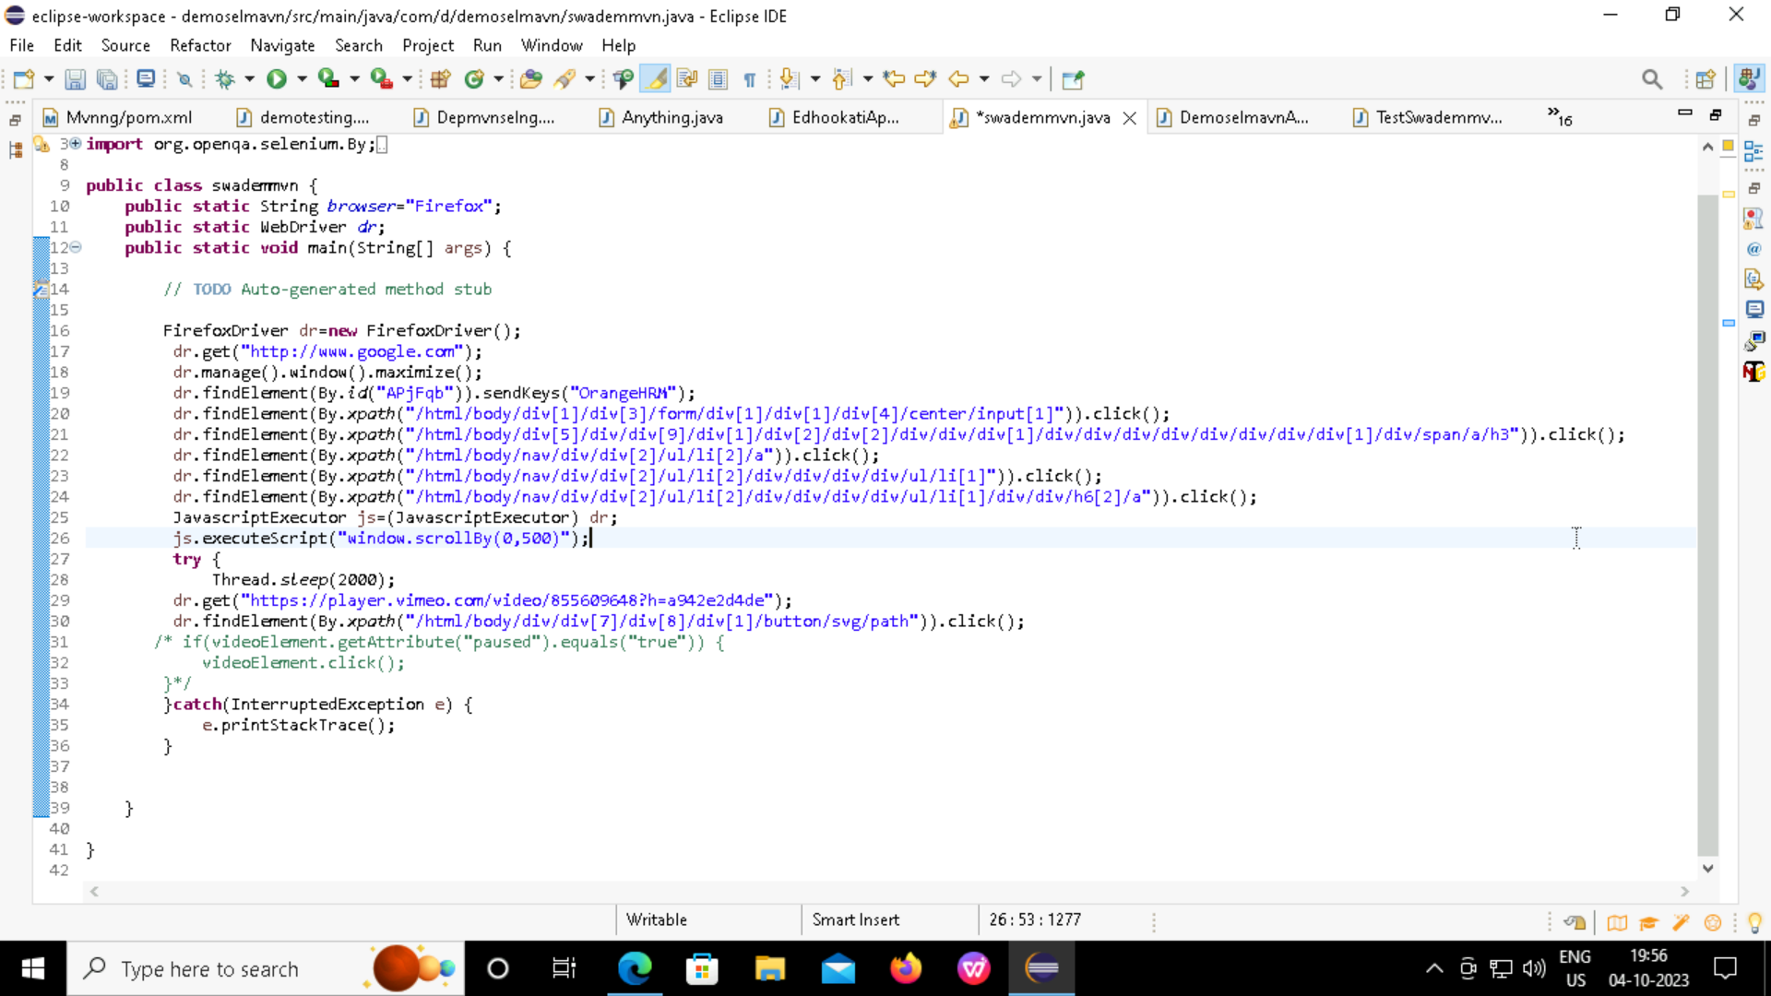

Slide 11
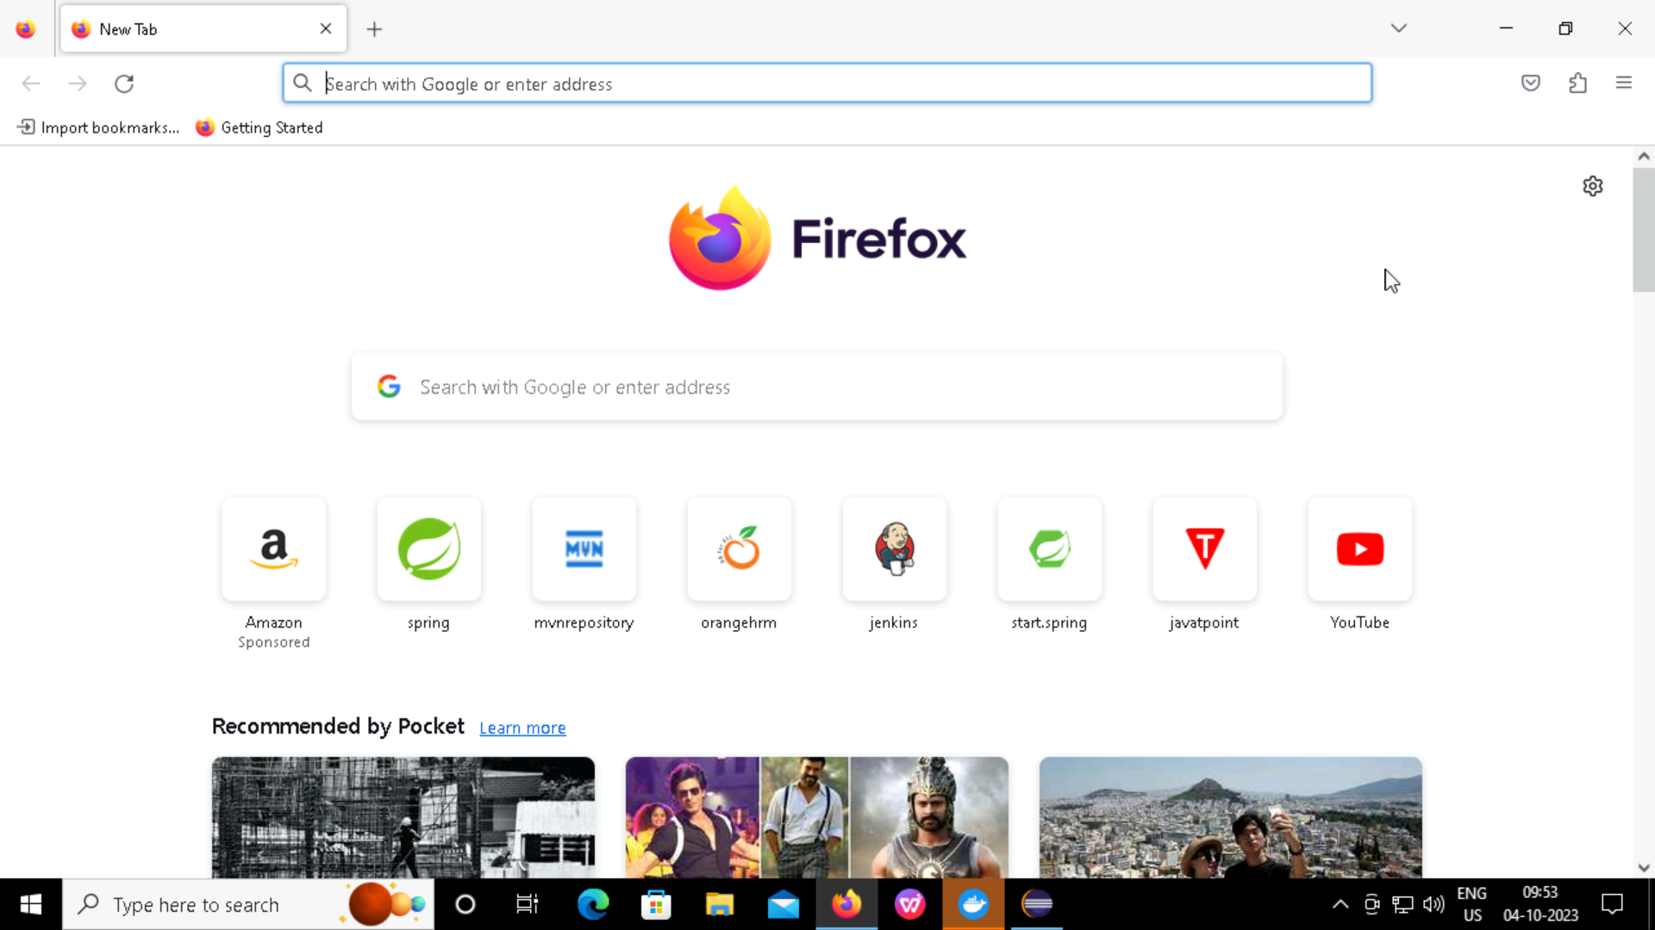
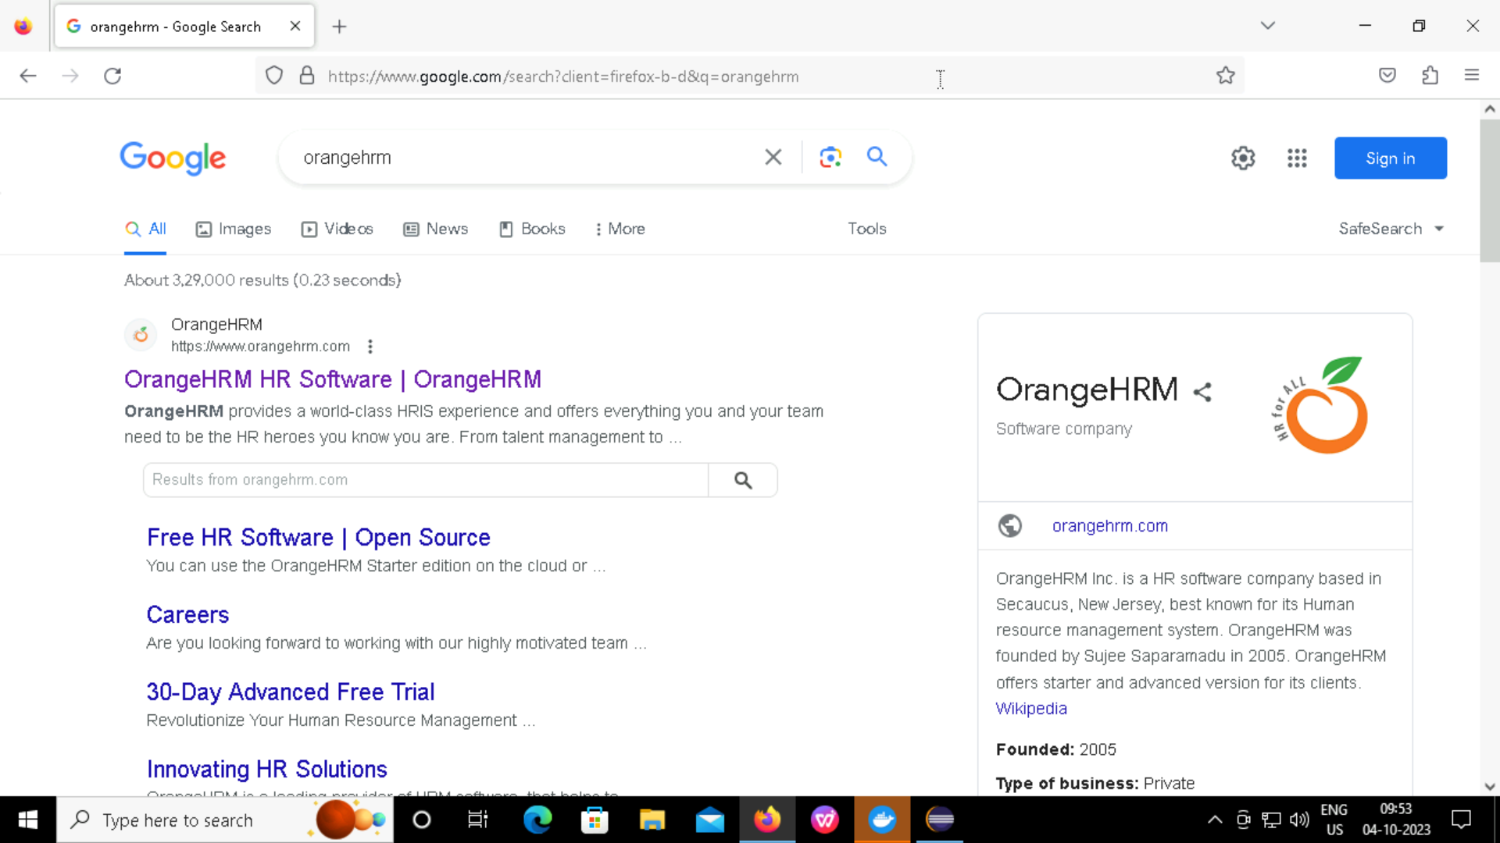


Slide 12
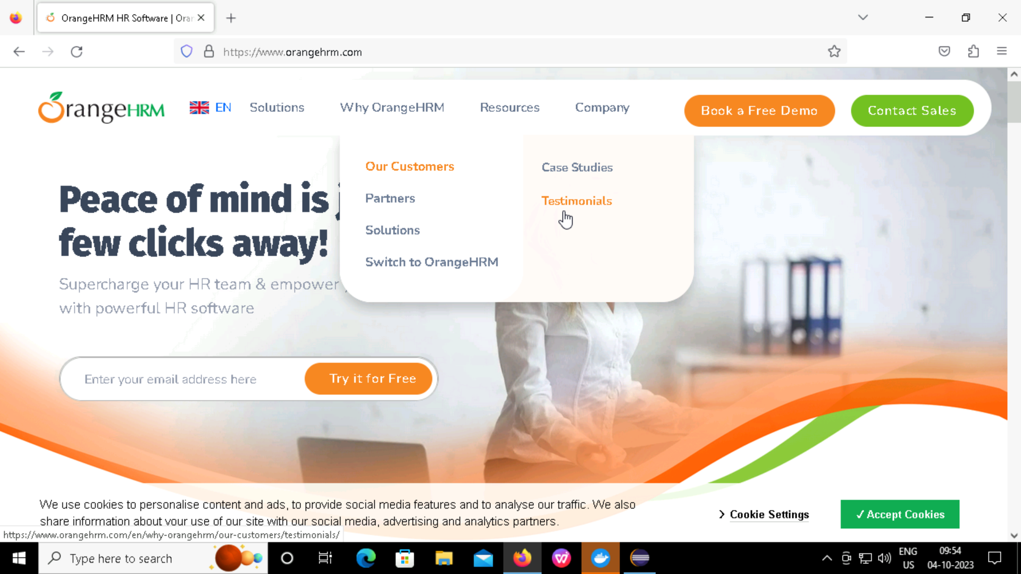




Slide 13
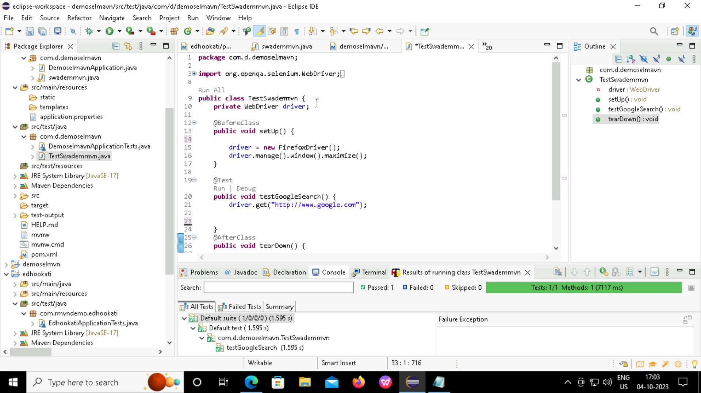
TestNG

Slide 14
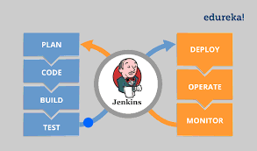
JENKINS Jenkins is an automation tool that is open-sourced and written in Java and has pluginJs built for continuous integration Jenkins is an opensource continuous integration/continuous delivery

Slide 15
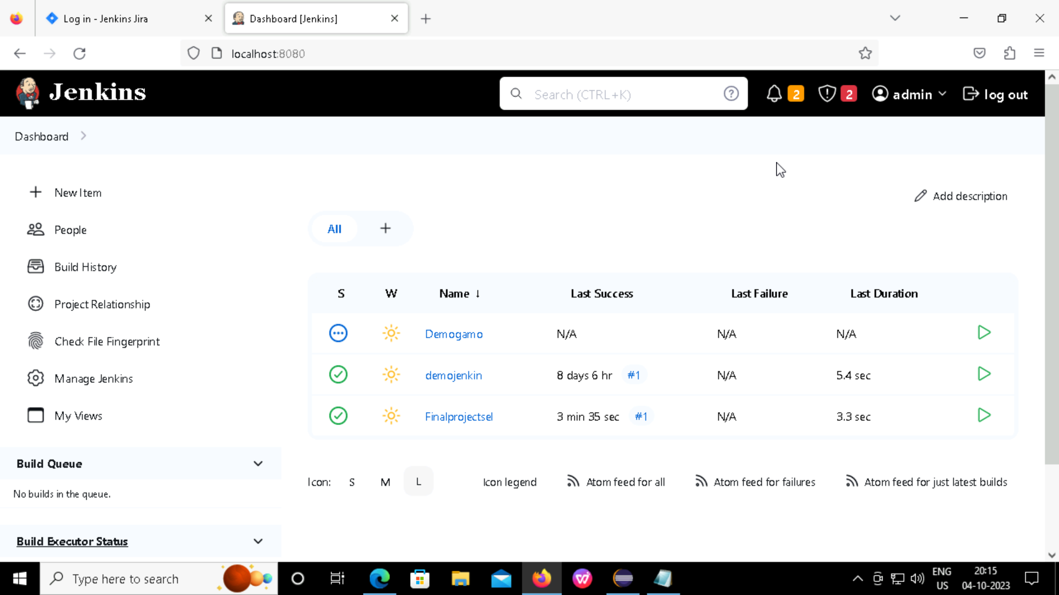
Finalprojectsel is Build Successfully..!

Slide 16

Thank you

